Slide 1
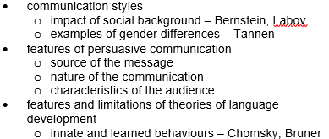
Unit 3 – Others – Communication

Slide 2

Syllabus Points:

Slide 3
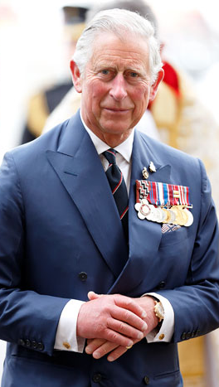
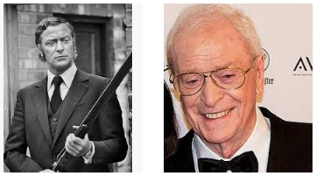
Communication Styles
Communication style: the cultural and social aspects of language
Factors influencing a person’s communication style: the culture in which they are raised, their socioeconomic background and their gender
Example to the right: the distance from Rotherhithe to Buckingham Palace is 5.2 miles (8.4kms)

Slide 4
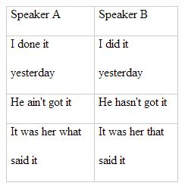
Communication Styles: Impact of social background – Bernstein
One of the first researchers to show an interest in the relationship between language style and social class
Bernstein claimed that people from the upper/middle classes and people from the working classes used different language codes
Restricted code: working class – conversation relied on preserving traditional roles and ways of interacting
Elaborated code: middle classes – wanted to develop ideas in relation to their personal experiences (could also use RC)
Working class children could understand but could not use EC
Bernstein introduced the idea of RC and EC to account for the relatively poor performance of working-class school pupils on language-based subjects, when they were achieving as well as their middle-class counterparts on mathematical topics
Resource: Communication Booklet Resource 2

Slide 5
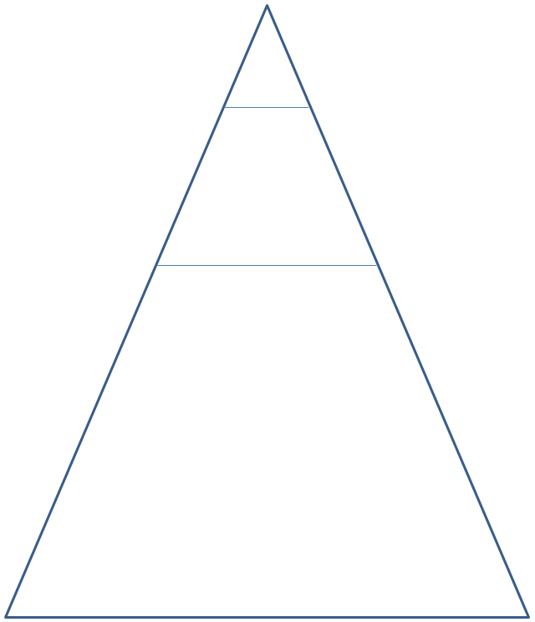
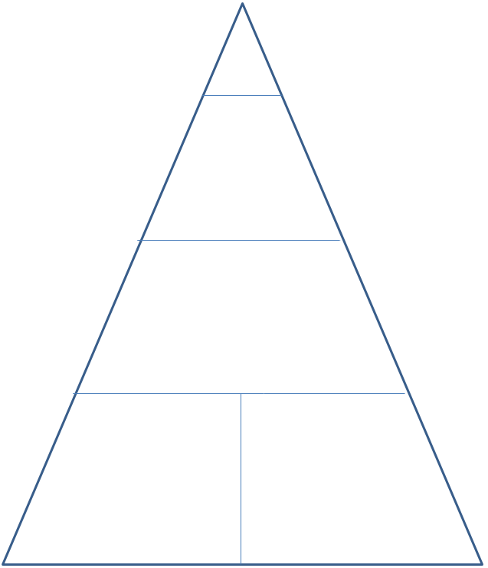
Social classes: pre and post-Industrial Revolution
Activity: identify the social class for each part of the pyramid and then identify the language code used by each (RC or EC)

Slide 6
Restricted and Elaborated Code – Differences
Restricted Code | Elaborated Code
Short and simple sentences are used, with much information conveyed non-verbally | Complex, precise sentences are used
Much of the meaning only makes sense if the context is known (‘he put it over there’) | The meaning is clear from the sentence alone (‘the boy put the spade in the shed’)
Few descriptive words are used | More use is made of descriptive words
Commands are frequently used to gain compliance | Explanations are usually used to gain compliance
The ‘here and now’ is stressed | Reference is made to events in the past or future
Abstract ideas are rarely expressed | Abstract ideas, future possibilities are expressed easily and often

Slide 7
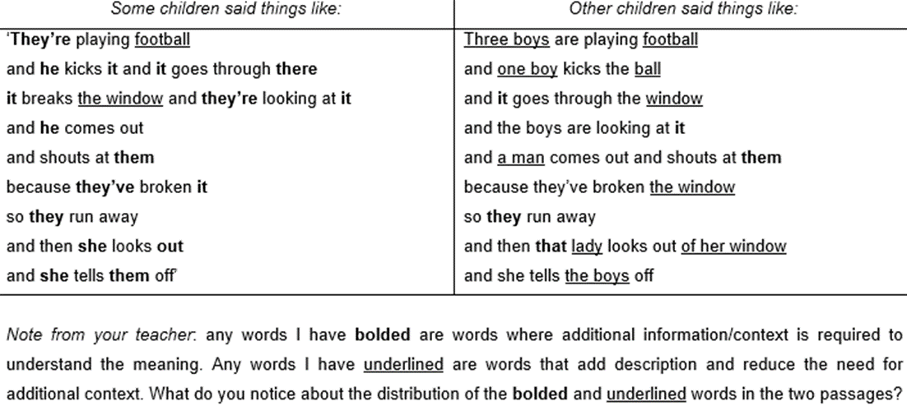
From your chapter summary… Bernstein’s research with children and their interpretations of a scene from a cartoon strip

Slide 8
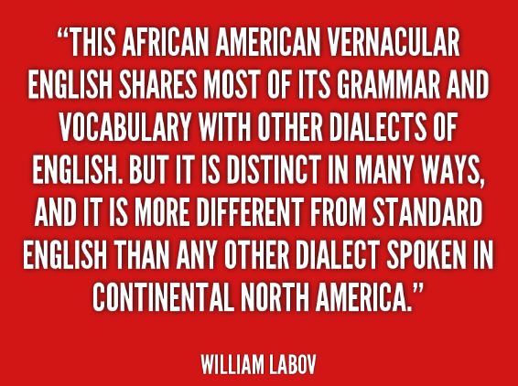
Communication Styles: Impact of social background – Labov
Labov’s ideas are based on his work with Black children from New York
These children spoke a dialect called Black English Vernacular (BEV = AAEV)
Bernstein would consider BEV to be a restricted language code
Labov considered BEV to be just as complex and rule-governed as standard English, and should be considered different but not deficient
For example, there is nothing more complex in the English comment ‘he doesn’t know anything’ than in the BEV comment ‘he don’t know nothing’
Numerous European languages use double-negatives
Labov was particularly concerned that teachers were being told not to accept BEV as it was useless for learning: “[Teachers] are being taught to hear every natural utterance of the child as evidence of his mental inferiority… this is bad observation, bad theory and bad practice”
Resources:
  Communication Booklet Resource 1
  Two Labov BEV clips on Connect

Slide 9
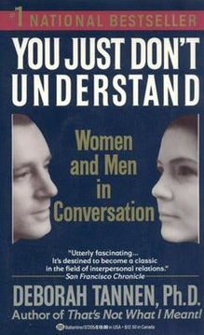
Examples of Gender Differences – Tannen
Men and women use differences in conversation – these differences may lead to breakdowns in communication
Identified two conversation styles:
  Rapport talk:
    the style of interaction that is based on establishing relationships, developing understanding and negotiating differences
  Report talk:
    the type of talk used by men
    men are comfortable holding centre stage
Key difference: women discuss problems with people as a way of building intimacy. What do men do when they hear a problem?
Resources: Communication Booklet Resources 3 and 4 (complete Resource 4 by watching the identified clips on YouTube)

Slide 10
Rapport and Report Talk – Differences
Rapport Talk (Women) | Report Talk (Men)
Use talk to establish and maintain emotional connections | Get more air time and exchange information with little emotional connection
Focus on personal and small talk ‘chat’ | Are more public with their talk
Use talk to build relationships and maintain intimacy | Use language to negotiate status and to avoid failure
Talk in turn – note error in text!!! | Tend to talk over and above one another, overlapping and simultaneous talk

Slide 11

Syllabus Points:

Slide 12
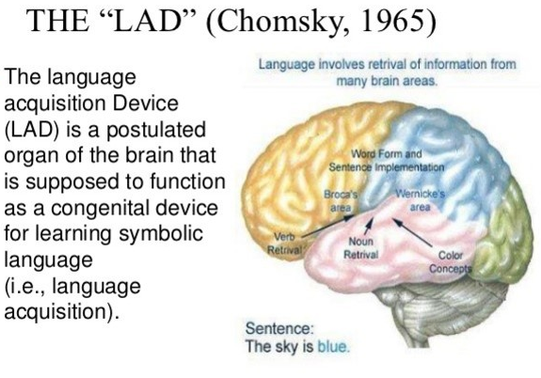
Features and limitations of theories of language development: Innate behaviours – Chomsky
LAD: Chomsky believed that humans have a metaphorical ‘black box’; children are genetically endowed with a specific facility for language, and this facility only requires linguistic input from a particular language community for children to generate grammatical structures of that language
In later development of his theory, Chomsky renamed the LAD as universal grammar
Chomsky’s rationale for the LAD – the language deficit: the limited information children receive is mathematically insufficient for them to determine grammatical principles, yet all children do this. Additionally, parents do not provide reliable feedback on whether their child’s developing language is grammatical or not. Correction is not given, but children still learn to talk in grammatical sentences and to understand the meaning of sentences from grammar (example: ‘John ate an apple’ and ‘John is too stubborn to talk to Bill’)

Slide 13
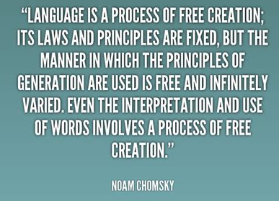
Features and limitations of theories of language development: Innate behaviours – Chomsky
Universal grammar (deep grammar rules): on the surface, all languages and dialects look and sound different. However, beneath the surface, basic principles are shared by all languages, making them fundamentally the same. Humans are born with universal grammar rules already built in (LAD) and this is what gives us the ability to learn any language
Surface structure: are the grammatical structures of spoken language : the words and sounds produced by a speaker and perceived by a listener
Example 1 – the idea of a person being chased by a dog:
  Universal grammar: the representation includes three pieces of encoded information: the mailman, the dog and the action of chasing
  Surface grammar: this idea can be verbally expressed by ‘the mailman is being chased by the dog’ or ‘the dog is chasing the mailman’
Example 2 – the colour of a car:
  In French: ‘Blue is the car’ (surface grammar)
  In English: ‘The car is blue’ (surface grammar)
  Universal grammar: the car (a noun), the colour blue (the adjective) and the relationship between the two
Criticism of LAD: paid little attention to the social environment in which the child was developing, except to acknowledge that the primary linguistic input came in the form of language being used in the family and the wider community
Resources: Communication Booklet Resources 6, 7, 8 and 9

Slide 14
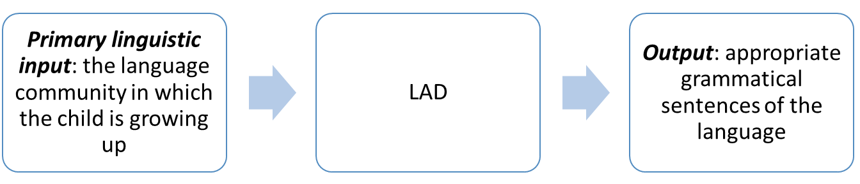
Chomsky’s Language Acquisition Device (LAD)

Slide 15
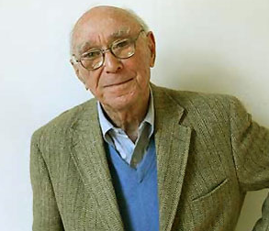

Features and limitations of theories of language development: Learned behaviours – Bruner
Believed that children’s language development takes place through parents talking to their children
Bruner’s (1983) findings are based on his two year longitudinal study of two boys from three months of age to approximately 24 months
Proposed a language acquisition support system (LASS)
“LASS requires LAD and vice versa” – Bruner
Resources: Communication Booklet Resources 8 and 9

Slide 16
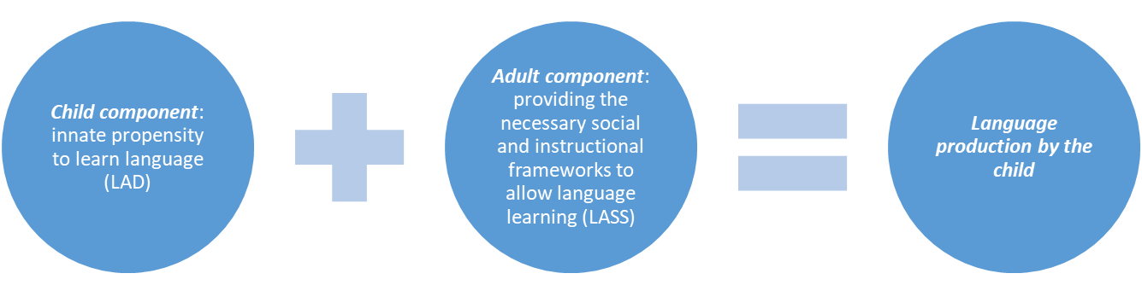
“LASS requires LAD and vice versa” - Bruner

Slide 17
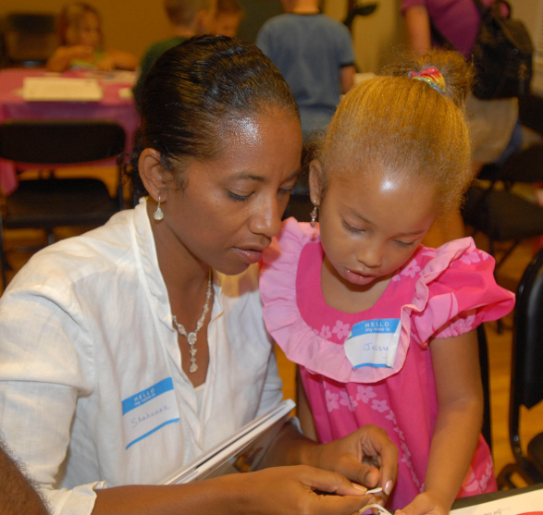

LASS’s instructional frameworks:
Scaffolding: interactional frameworks provided by adults (in Bruner’s research these were provided by the mother) that allow language to develop. It is important the mother stays one step ahead and ‘pushes’ the child with development of language
Formats: well-known, familiar and comfortable routines and activities (e.g. meal and bath times, joint book reading) used to ‘push’ the child beyond his/her current capabilities to talk more, to use new words and to learn new meanings
Reference: how people manage and direct each other’s attention by linguistic means, and develops out of non-linguistic methods of directing attention (pointing, turning of the head to look). In very young children sounds accompany these gestures until eventually the sounds replace the gestures
  Joint attention: the shared focus of two individuals on an object – one individual (often the mother) alerts the child to an object by means of eye-gazing, pointing or verbal means
  Book reading: a context (format) within which children learn about books, the meanings associated with words, and the use of language

Slide 18

Syllabus Points:

Slide 19
Communication – what exactly is it?
Put simply, communication is simply the transmitting of a message between a sender and receiver
As such, a message can be either verbal (i.e. spoken) or non-verbal (i.e. body language)
Effective communication occurs when the receiver of the message receives and interprets the message in the way it was intended by the sender
Effective communication includes both sender and receiver attributes

Slide 20

Persuasive Communication
Definition: using language as a means of attempting to change the beliefs, feelings and behaviours of others
Three variables that occur in the context of persuasion are the:
  Source of the message
  Nature of the communication
  Characteristics of the audience

Slide 21


Persuasive Communication
Petty & Cacioppo’s (1986) elaboration-likelihood model of persuasion:
  Central route to persuasion: consists of thoughtful consideration of the content of the message by the receiver as an active participant in the process of persuasion. Central processing can only occur when the receiver has both the motivation and the ability to think about the message and the content
  Peripheral route to persuasion: occurs when the listener decides whether to agree with a message based on cues other than the content of the message, such as source expertise or attractiveness of the source

Slide 22
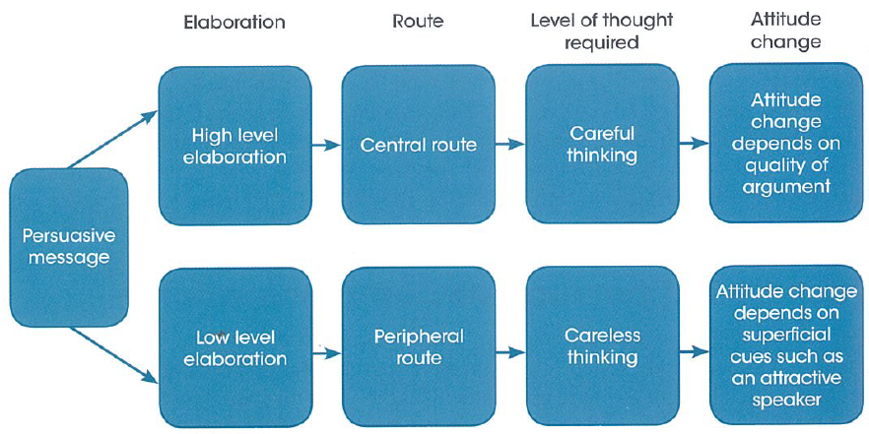
Persuasive Communication - Petty & Cacioppo’s (1986) elaboration-likelihood model of persuasion

Slide 23
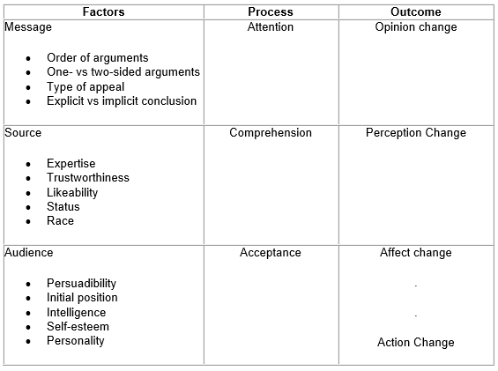
Persuasive Communication
Hovland, Janis and Kelley’s (1953) Yale approach to persuasive communication:
Hovland, Janis and Kelley asked, ‘Who says what to whom and with what effect’
They studied three general variables involved in persuasion:
  the communicator, or the source (who)
  the communication, or message (what)
  the audience (to whom)
Hovland and his colleagues identified four distinct steps in the persuasion process:
  attention,
  Comprehension
  Acceptance
  Retention
Their research program spanned nearly three decades and produced a vast amount of data

Slide 24
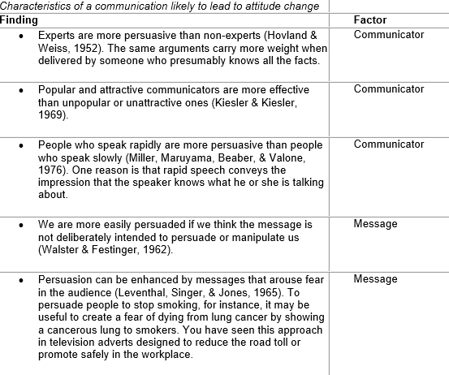
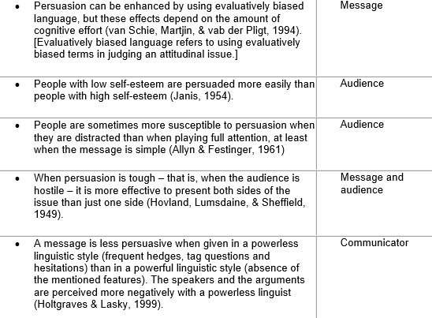
Hovland, Janis and Kelley’s (1953) Yale approach to persuasive communication – key findings:

Slide 25
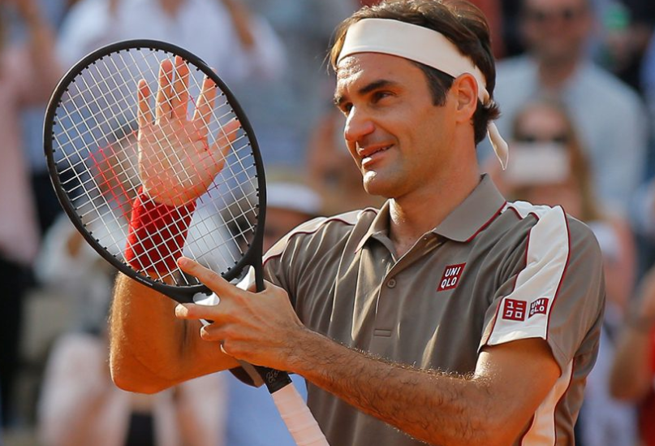
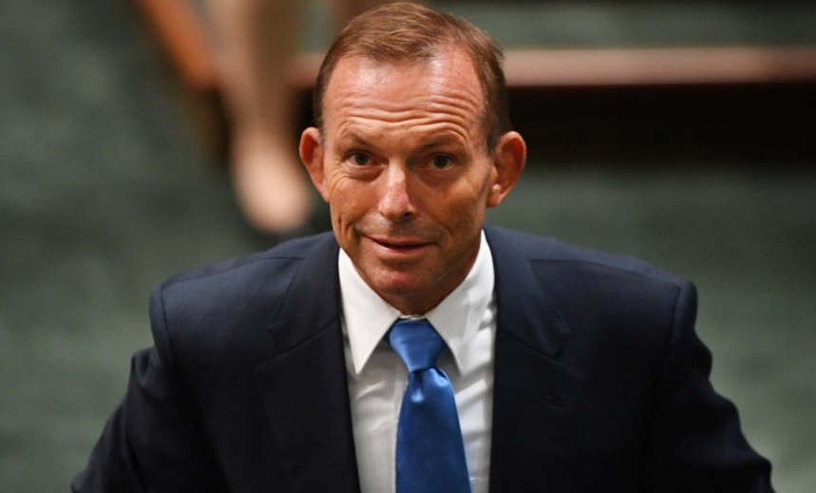
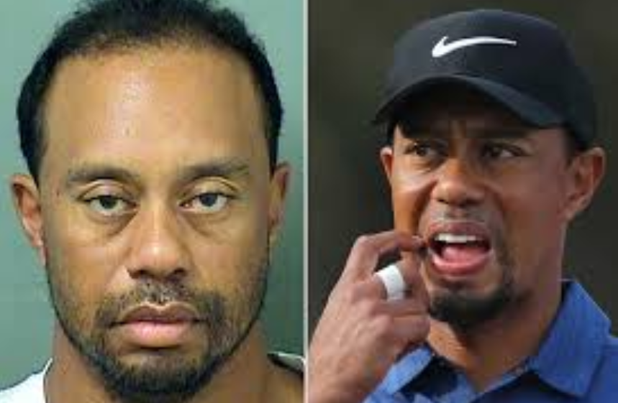
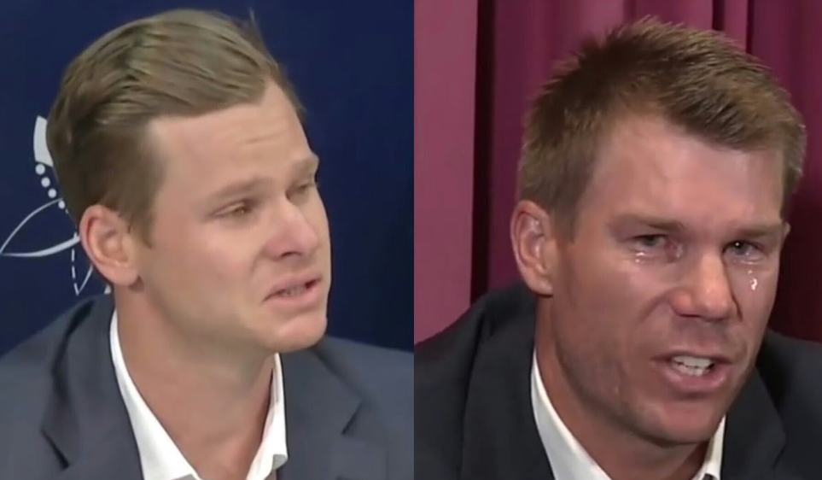
Persuasive Communication: Source of the message
Refers to the origin of the persuasive message
Persuasive factors relevant to the source of the message include:
  Use of an expert: to sell a product within the area of their expertise
  Use of an expert: to sell a product outside of their area of expertise
  Speed of the communication: as long as the gist of the message can be understood the faster the talker the more intelligent and knowledgeable they are considered to be
  Trustworthiness: consider sportspeople, politicians...

Slide 26

Persuasive Communication: Nature of the communication
This refers to the content of the message itself as well as the medium used for communication between the source and the audience (e.g. speaking, writing, SMS, a tweet)
Research indicates that comprehension of printed advertisements and information is higher than for information presented on television
A message will often aim to provoke an emotional response in an effort to persuade the audience: happiness, guilt, fear and anxiety are common emotions advertisers try to provoke from the audience

Slide 27

Persuasive Communication: Characteristics of the audience
The content or presentation style of the message will change depending on a range of characteristics of the audience including their:
  Age
  Relationship to us
  Level of education
  Sex
  Culture
  Whether they have a high or a low need for cognition

Slide 28
Persuasive Communication: Now for some examples
Advertisement Name | Trying to persuade audience to…? | Central and/or Peripheral Route Used? | Source of Message | Nature of Communication | Characteristics of the Audience

